Slide 1

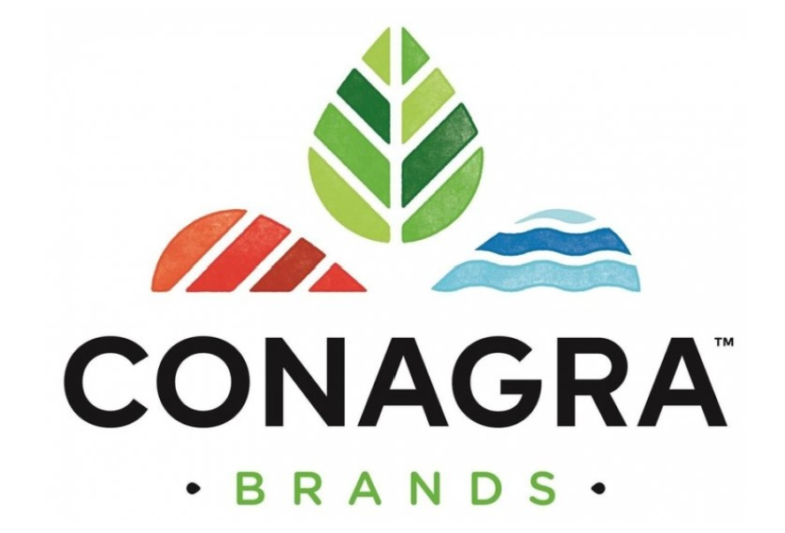
Unleashing the Power of Predictive Analysis on Company Data
Team members:
Harshini Parepally
Keerthana Panyala
Vishal Kanna
Aaditya S
Mohanish Pradeep
Kushagra Rastogi

Slide 2
Overview
In the context of business, predictive analysis can be used to identify trends, patterns and potential risks or opportunities within a company's data.
A thorough examination of market trends, sales distribution with respect to geography, demographics, and the competitive environment in the Table Spreads, cooking oil & sprays category was performed.

Slide 3
Objective
Our ultimate goal is to assist Conagra in realizing their full growth potential and increasing their market share in the highly competitive and continually expanding Table spreads domain.
The success of this project will allow Conagra to acquire a larger portion of the Tablespreads market and drive long-term sustainable growth.

Slide 4
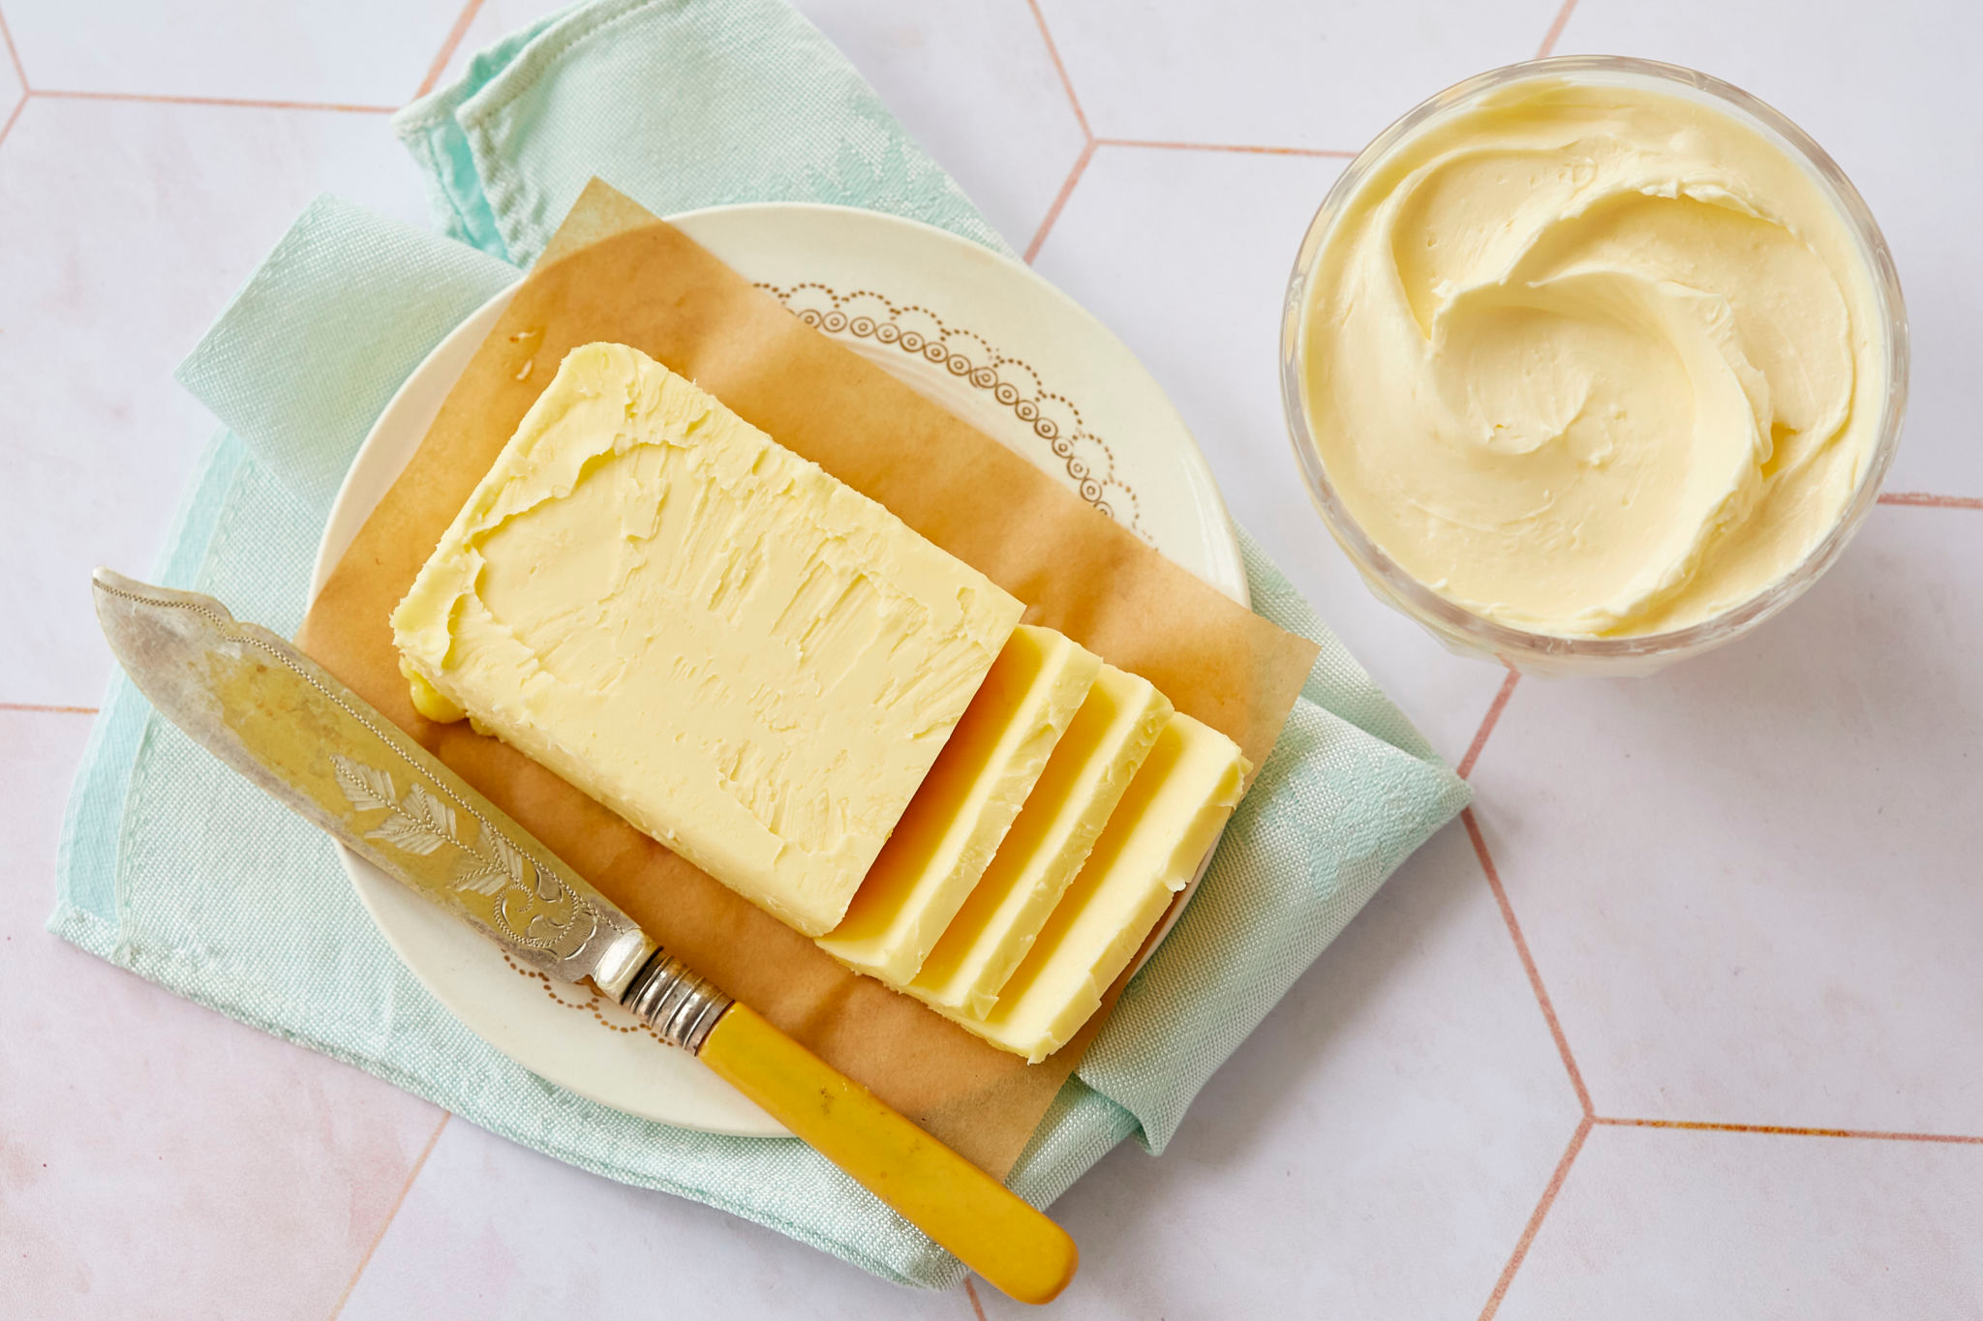
TABLESPREADS

Slide 5
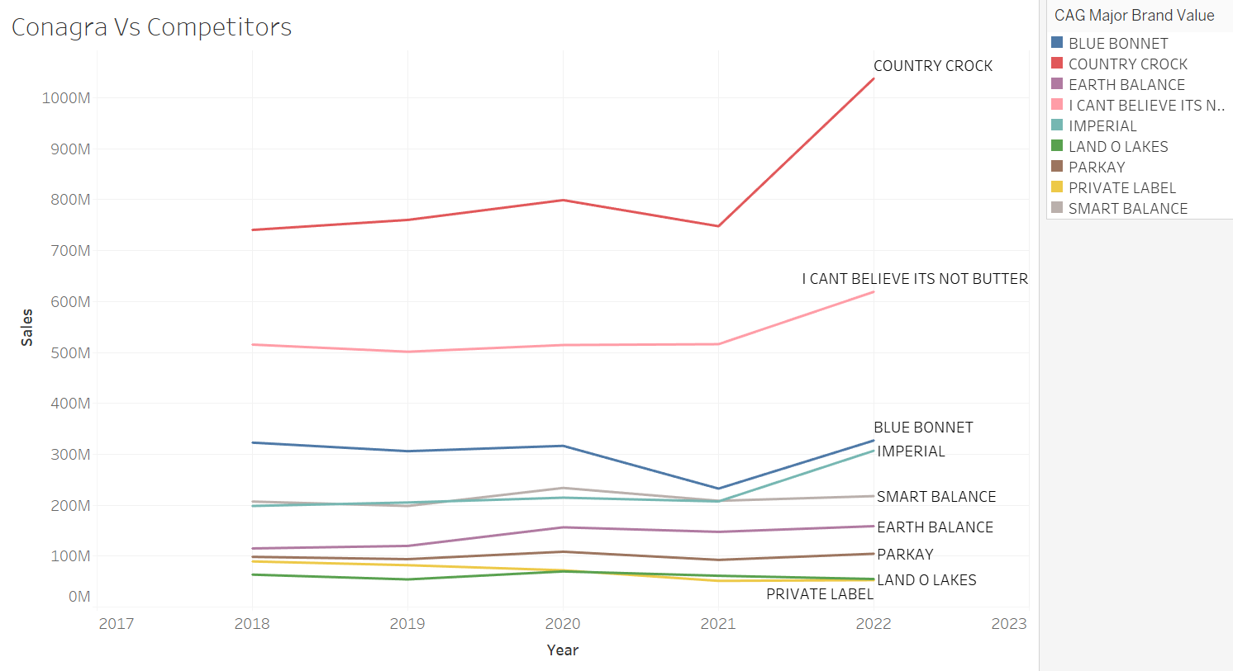
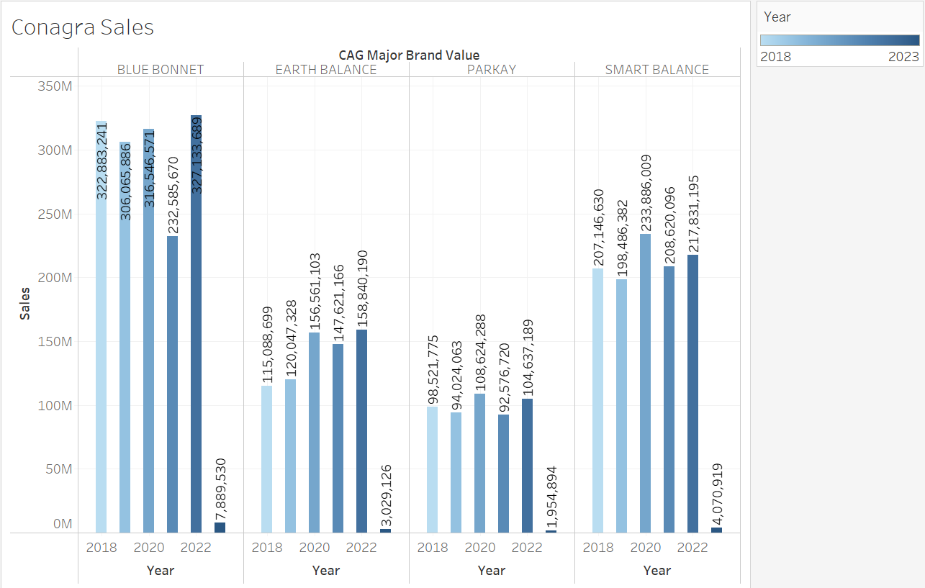
Analysis by Sales
The above charts represent combined sales of butter and margarine for Conagra brands vs Competitors(left) and Conagra brands exclusively(right)

Slide 6
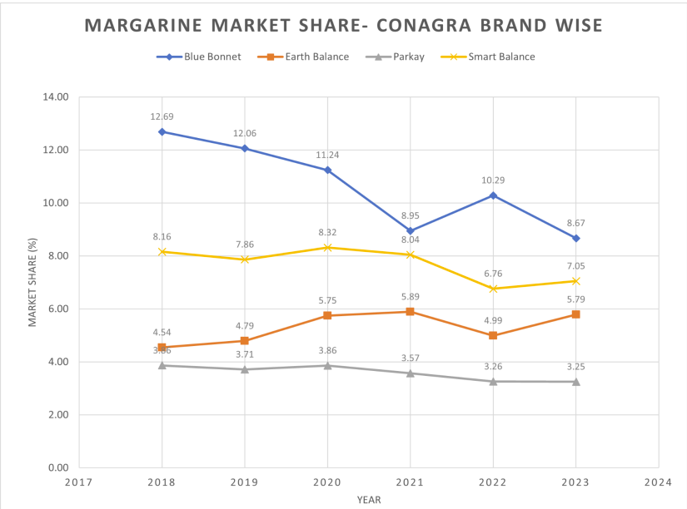
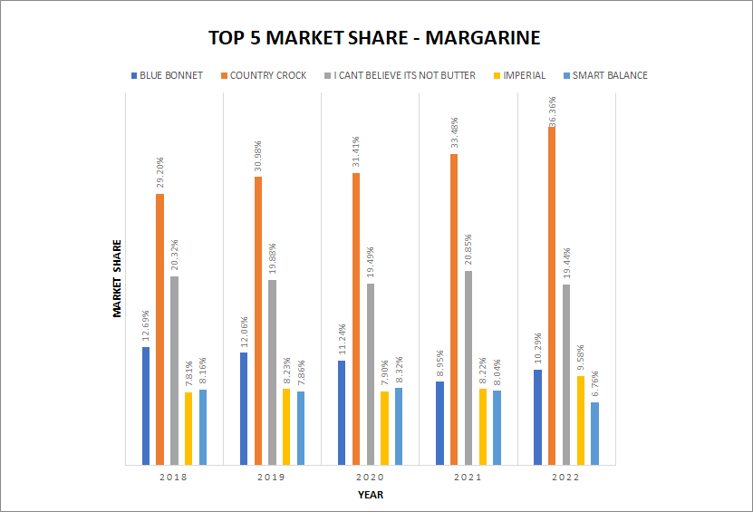
Analysis by Market Share - Margarine
The above graph represents the year wise distribution of market shares for all the conagra brands.
Evidently, Blue Bonnet was the forerunner when compared to all the other alternatives.

Slide 7
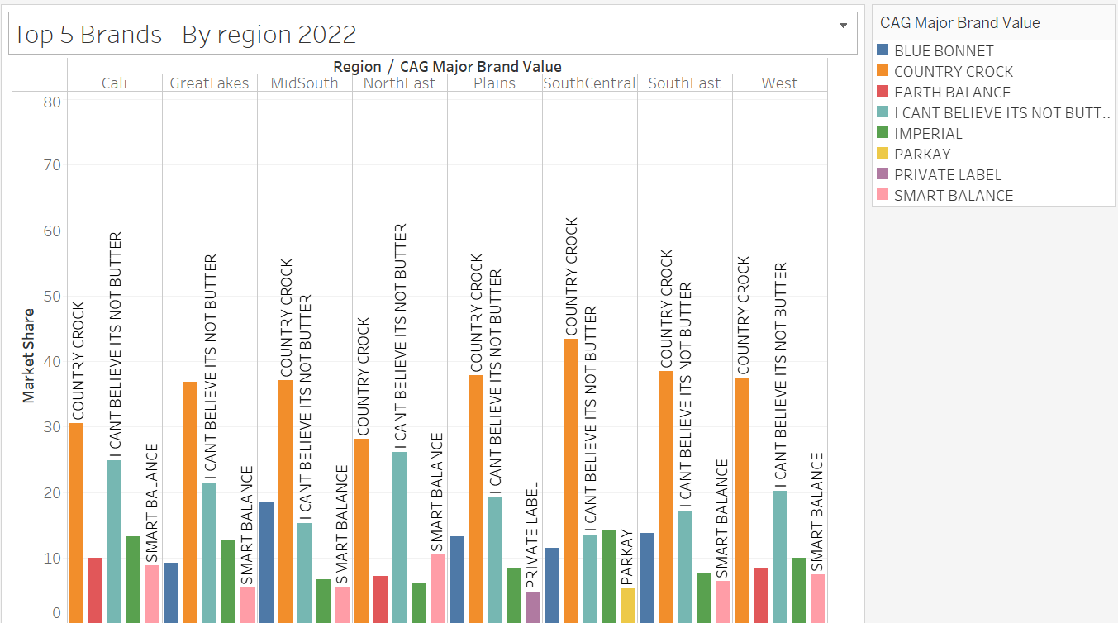
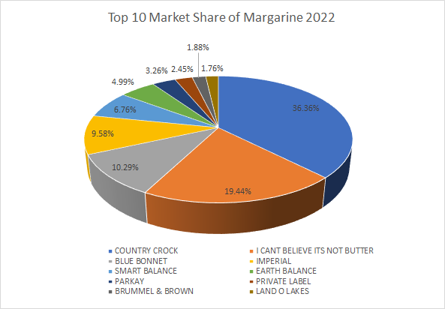
Analysis by Market Share (2022)
The pie chart suggests that Blue Bonnet- 10.29% and Smart Balance- 6.76% were positioned among the top 5 leaders of market share for margarine.

Slide 8
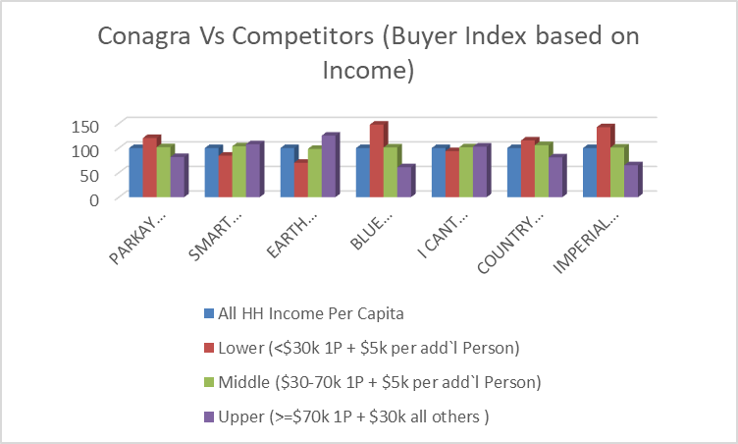
Table Spreads Category (Analysis based on Demographics)
Income Range | Competitor
Low | IMPERIAL
Medium | COUNTRY CROCK
High | -

Slide 9
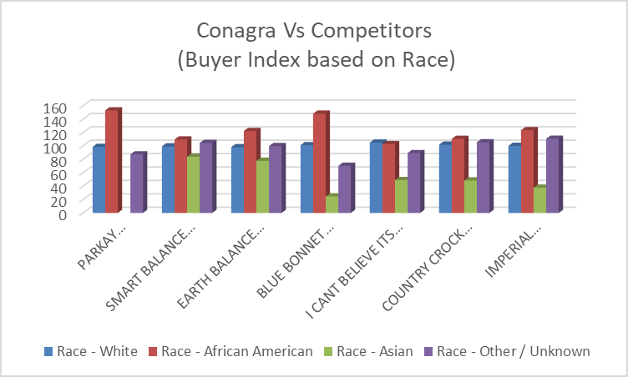
African Americans purchase table spreads the most and they prefer Parkay and BlueBonnet. There is not much competition for Conagra Brands when race is considered.

Slide 10
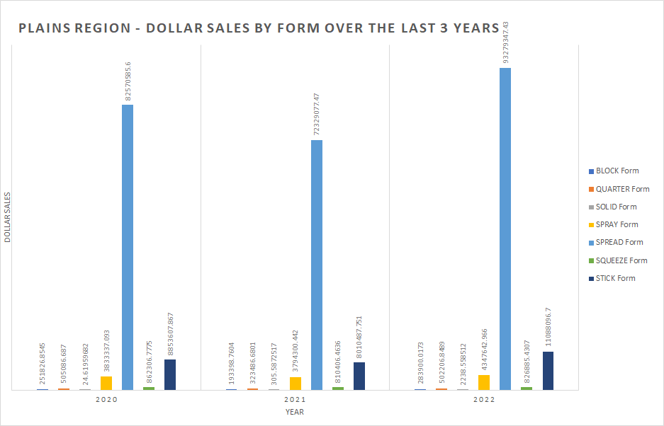
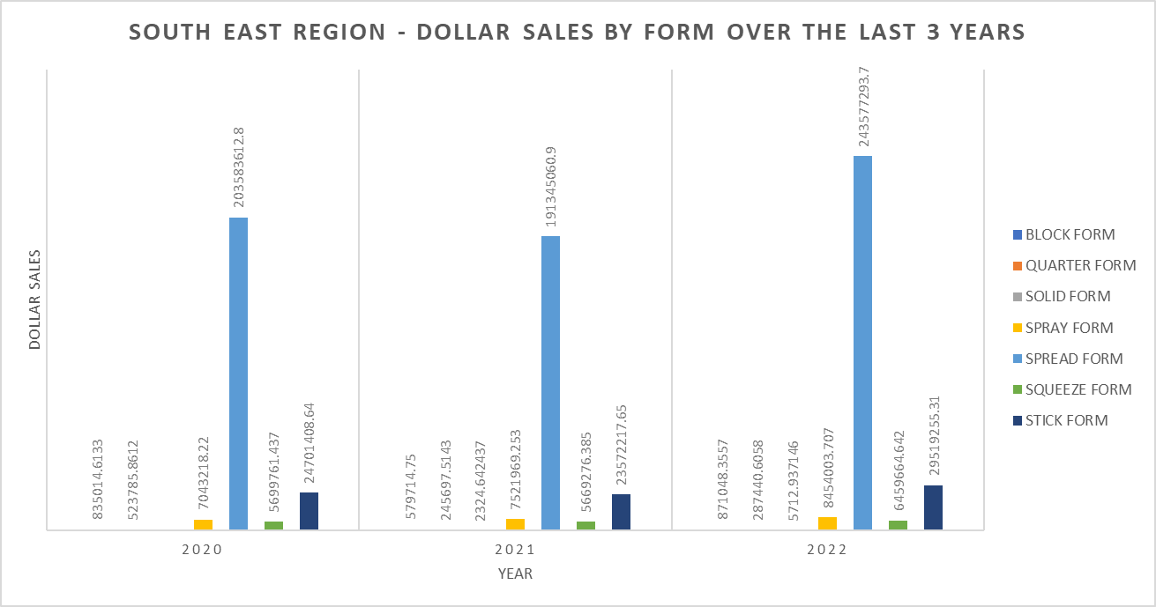
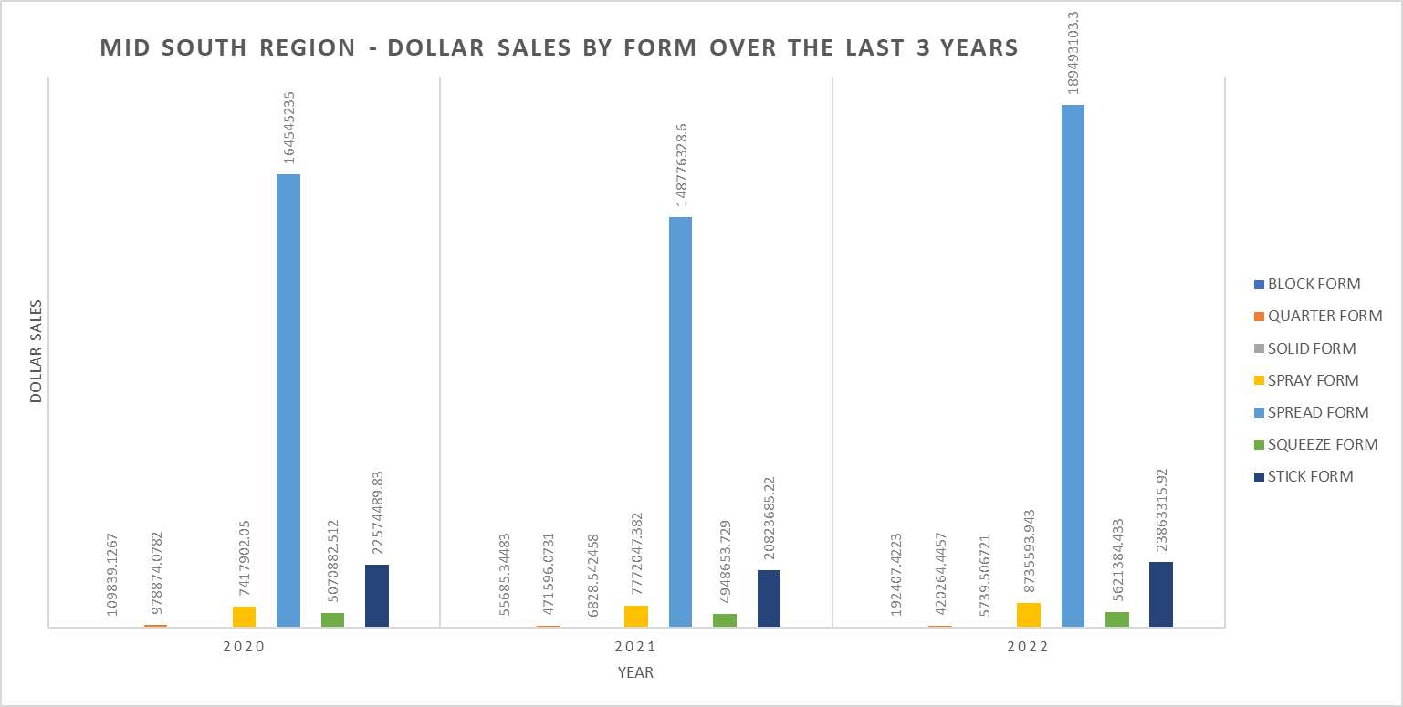
Analysis by Geography
The spread form sells the most among table spreads, keeping up with trends of the overall market. This is true for the plains region, south east region and the mid south region

Slide 11
Prediction for 2023 (Margarine)
Brand | Market Share Prediction 2023
Blue Bonnet | 8.87%
Smart Balance | 7.2%
Earth Balance | 5.63%
Parkay | 3.3%

Slide 12
Prediction for 2023 (Total Market Share)
Brand | Market Share Prediction 2023
Blue Bonnet | 2.66%
Smart Balance | 2.14%
Earth Balance | 1.78%
Parkay | 0.99%

Slide 13
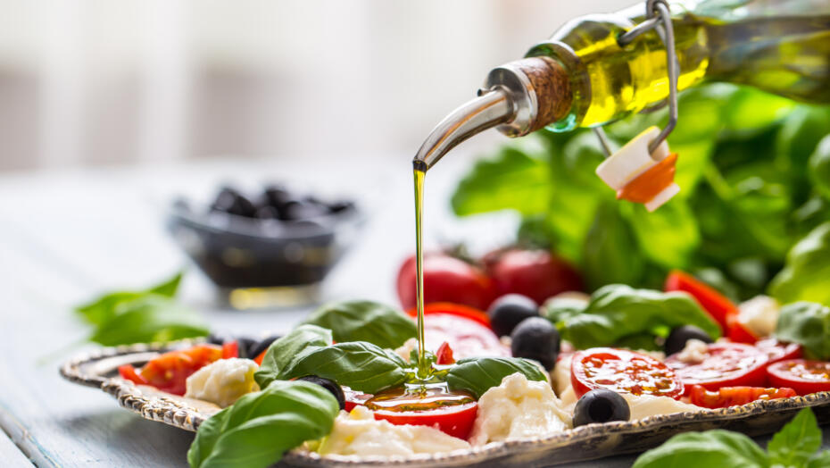
COOKING AND SALAD OIL

Slide 14
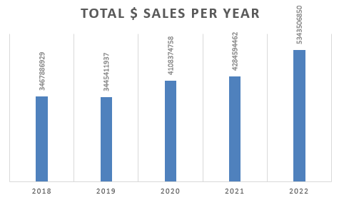
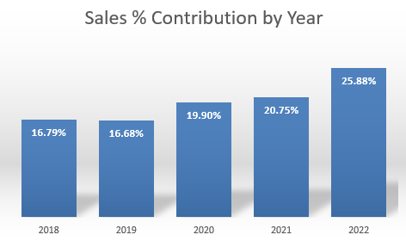
Overview of the market
Year 2022 has been the most promising one accounting for 25% of all sales in terms of total dollar sales.
The market size has grown over the years with 2019 being an exception (possibly due to increase in prices post COVID-19)

Slide 15
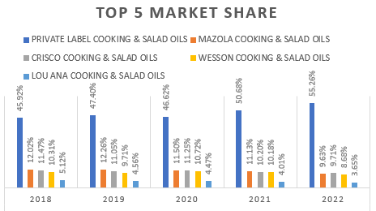
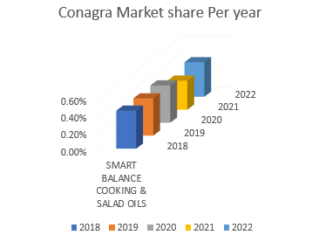
Chart (Right) indicates Private label with around 50% of market share as a major player.
Chart (Left) shows conagra’s market share to be more or less stable (at around 0.5%) except for the year 2021.

Slide 16
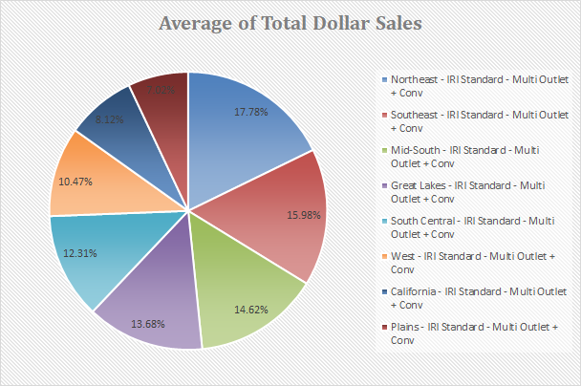
CONTRIBUTION OF DIFFERENT REGIONS IN CONAGRA’S TOTAL MARKET SHARE:
South-East remains to be the most promising region as it has grown the highest over the years (It has been consistently around 16%).
Mid-South is the second best contributor with around 14% of total sales.
The remaining regions have been more or less consistent in terms of their contribution.
Even though they remain constant a deeper look at year-wise percentage share tells us that :
For the year 2022 Mid-South is the second largest contributor with over 15 percent share overtaking North-East for the second spot.
Other regions have constantly receded over the years in terms of the share in contribution.
This could be a result of increased customer base or purchasing in the regions of South-East and Mid-South than compared to other regions despite the other regions not taking a hit.
NOTE:
The figure represents the average of sales for all the years for the purpose of representation.

Slide 17
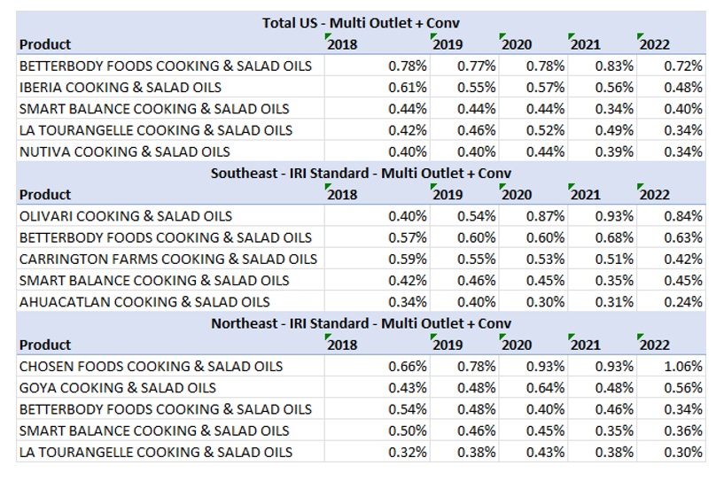
REGION WISE LOOK AT COMPETITORS:
Betterbody foods cooking and salad oils remain the most active competitor across all the regions with a better market in all of them.
The buyer distribution Index for both Conagra and Betterbody foods suggests overlapping consumer base suggesting active competition.
Smart balance’s market share in the all US - Multi outlet region has come down by 0.90 percent to 0.80 percent.
The company has done well to hold on to its market share in the Southeast region despite tough competition.
Northeast remains to be an area of concern as the market share has come down from 1 percent in 2018 to 0.72 percent in 2022.
By looking at the trend line for smart balance product we conclude that it is either remaining flat or receding in all the 3 regions.
NOTE - Other metrics such as total units sold must also be looked at for conclusive evidence.

Slide 18
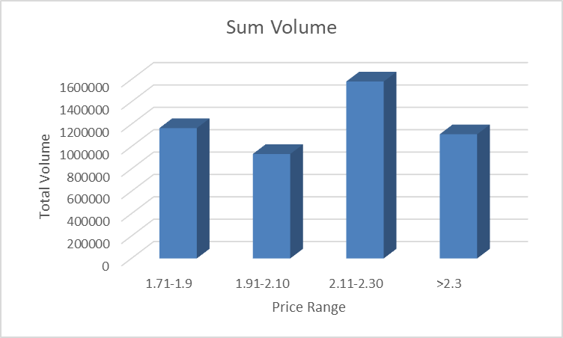
Sample analysis of Price per volume (No merch) Vs Sum volume sales (No merch) for Total US-Multi Outlet + Conv region for the year 2022 for SMART BALANCE:
we see the highest sale in the price range of 2.11-2.30 dollars, the second highest being in the price range of 1.71-1.9 dollars.
we see customers choosing oil on the lower end of the price but most have bought smart balance irrespective of the slight price difference suggesting them to be loyal customers.
Any increase after 2.3 dollars per unit volume would not be suggested. This can further be cross-checked for similar brands.
A similar analysis of top selling brands with similar (in terms of demographics such as age, race and income of customers) buyers will help understand the max price range upto which the market is willing to pay.

Slide 19
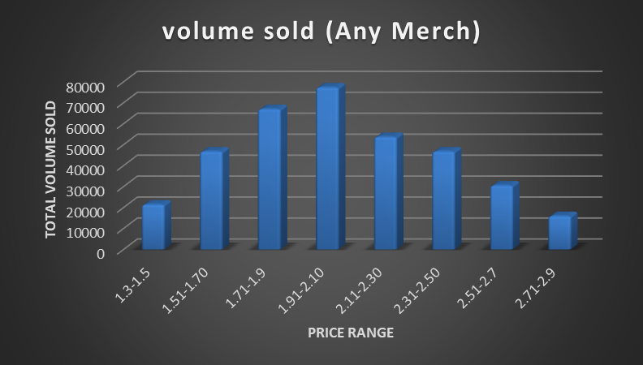
Sample analysis of Price per volume (any merch) Vs Sum volume sales (any merch) for Total US-Multi Outlet + Conv region for the year 2022 for SMART BALANCE
The above graph clearly shows that most volume has been sold when the price range is between 1.9 to 2.1 dollars.
Customers have purchased more when the offer price (any merch) was neither too high nor too low indicating they didn't either want to purchase clearing stock or those with less offers.
The above data clearly suggests that most likely these are not loyal customers but are those who are highly price sensitive.
A similar analysis of the same for other brands will help us understand how loyal the customer base is and what is the ideal price range.

Slide 20
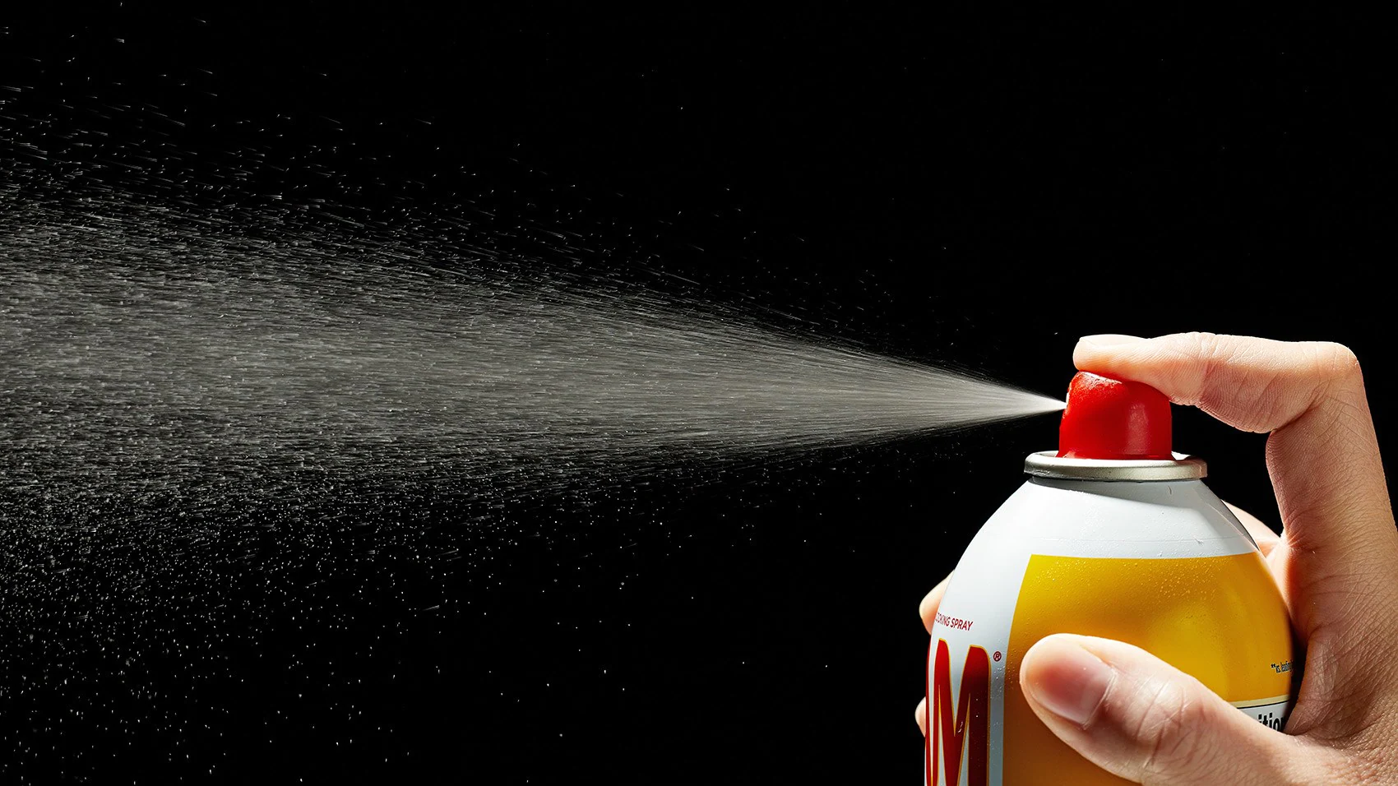
COOKING SPRAYS

Slide 21
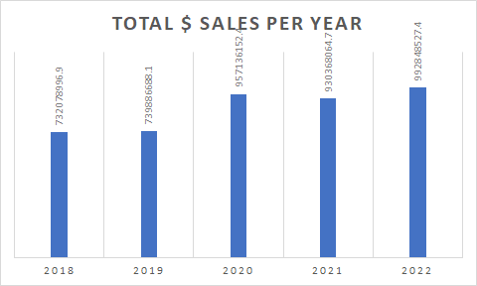
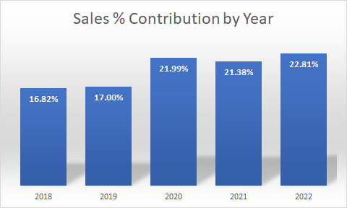
OVERVIEW OF THE MARKET:
By looking at the above graph we get following takeaways:
There is a significant increase in the sales amounting to rise in Total dollar sales across all regions in the year 2020. This is possible as people stayed indoors and cooked for themselves rather than eating out due to the pandemic.
The market has remained stable after that owing to the fact that oil sprays are healthier options when compared to the salad and cooking oils.

Slide 22
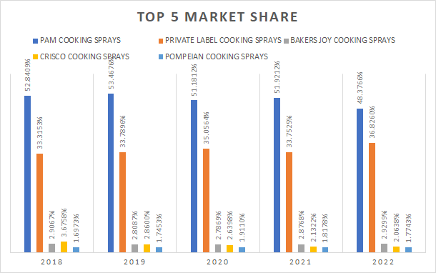
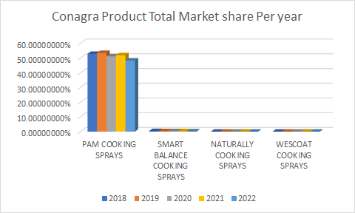
Market Analysis for cooking sprays and CONAGRA BRANDS
Picture (Right) gives following observations:
The PAM COOKING SPRAYS by CONAGRA BRANDS is the market leader with over 50% market share over the years.
Year 2022 hasn't specifically been a good year as it seems to have lost significant share of the market to PRIVATE LABEL
This needs to be considered carefully as any further drop will narrow the gap leading to tough competition.
Picture (Left) gives following observations:
The PAM COOKING SPRAYS remains the most selling brand followed by SMART BALANCE COOKING SPRAYS with an average of 0.3%.
The NATURAL COOKING SPRAYS AND WESTCOAT COOKING SPRAYS are almost negligible in terms of market share.

Slide 23
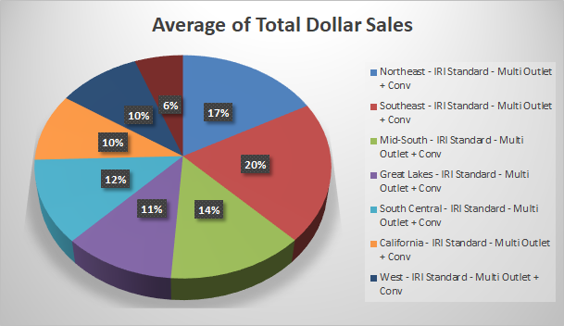
CONTRIBUTION OF REGIONS IN SMART BALANCE COOKING SPRAYS MARKET SHARE:
By looking at the above graph we can understand that similar to the oil category, the Northeast and Southeast has the highest share.

Slide 24
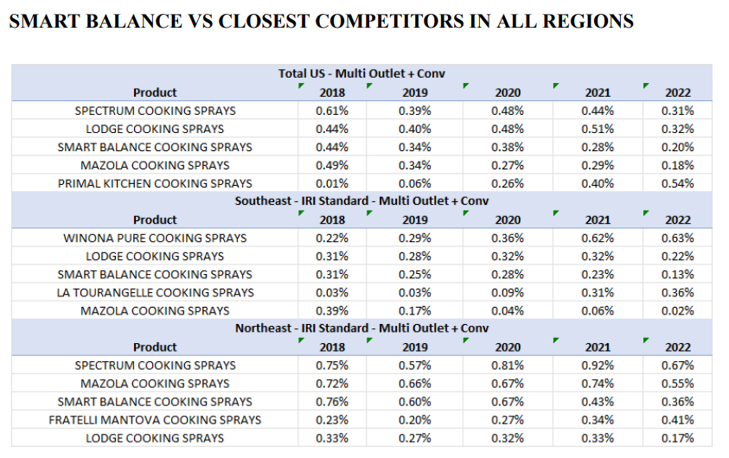
SMART BALANCE VS CLOSEST COMPETITORS IN ALL REGIONS
Following observations can be made:
SMART BALANCE is losing out on its sales significantly in all the regions.
If proper steps aren’t taken there is a serious threat of extinction from the market for SMART BALANCE.

Slide 25
Recommendations
Strengthen Blue Bonnet
Expand Smart Balance
Capture Emerging Market Segments
Regional Focus : Earth balance - California, Blue bonnet - mid south, plains, south central and southeast, Smart balance - northeast , Earth balance - west

Slide 26
THANK YOU!

